Slide 1
Computer Principles for Programmers
Preview of course topics and looking into the ICT News

Slide 2
Quiz

Slide 3
News of the Week – readable slide
ICT NEWS
CBC Tech Spark
Globe and Mail Tech
WWW Foundation
Mozilla internet citizen
MIT Tech Review
IT World Canada
IT business
Techmeme
Slashdot
Notes:
Google: ict news canada, it news websites
https://webfoundation.org/ The World Wide Web Foundation was established in 2009 by web inventor Sir Tim Berners-Lee to advance the open web as a public good and a basic right.
https://blog.mozilla.org/ We make the internet safer, healthier and faster for good. Mozilla is the not-for-profit behind Firefox, the original alternative browser. We create products and policy to keep the internet in service of people, not profit.
https://www.technologyreview.com/
http://www.itworldcanada.com/
http://www.itworld.com/
http://www.computerweekly.com/
http://www.computerworld.com/
Techmeme - http://www.techmeme.com (aggregator with human editing)
Slashdot - http://slashdot.org/ (aggregator with human editing)
https://www.huffingtonpost.com/section/technology
Ars Technica - http://arstechnica.com/
https://www.theguardian.com/uk/technology
Technowize - https://www.technowize.com/
CNET - http://www.cnet.com/ ( -ZDNethttp://www.zdnet.com/ )
Digital Trends - http://www.digitaltrends.com
Engadget - http://www.engadget.com/
GigaOM - http://gigaom.com/
Gizmodo - http://gizmodo.com/
Mashable - http://mashable.com/
ReadWrite - http://www.readwrite.com
The Next Web - http://thenextweb.com/
The Verge - http://www.theverge.com/
TechCrunch - http://techcrunch.com/
TechRadar - http://www.techradar.com/

Slide 4
News of the Week – unreadable slide
Google: ICT NEWS
https://www.quora.com/What-are-the-best-sources-for-tech-news
http://www.itworldcanada.com/
http://www.itworld.com/
http://www.computerweekly.com/
http://www.computerworld.com/
https://blog.mozilla.org/internetcitizen/
http://www.wired.com/
News Aggregators
Techmeme - http://www.techmeme.com (with human editing)
Slashdot - http://slashdot.org/ (with human editing)
YC Hacker News - http://news.ycombinator.com (with voting)
Hacker News - http://hackernews.org/ (rss feeds)
News Sources
CBC Tech Spark Globe and Mail Tech
WWW Foundation Mozilla internet citizen
MIT Tech Review
Ars Technica - http://arstechnica.com/
CNET - http://www.cnet.com/ ZDNet - http://www.zdnet.com/
Digital Trends - http://www.digitaltrends.com
Engadget - http://www.engadget.com/
Guardian – International USA
GigaOM - http://gigaom.com/
Gizmodo - http://gizmodo.com/
HuffPost - https://www.huffingtonpost.com/...
Mashable - http://mashable.com/
ReadWrite - http://www.readwrite.com
The Next Web - http://thenextweb.com/
The Verge - http://www.theverge.com/
TechCrunch - http://techcrunch.com/
TechRadar - http://www.techradar.com/
Technowize - https://www.technowize.com/
Notes:
Google: ict news canada, it news websites
https://webfoundation.org/ The World Wide Web Foundation was established in 2009 by web inventor Sir Tim Berners-Lee to advance the open web as a public good and a basic right.
https://blog.mozilla.org/ We make the internet safer, healthier and faster for good. Mozilla is the not-for-profit behind Firefox, the original alternative browser. We create products and policy to keep the internet in service of people, not profit.

Slide 5
Preview of the weeks to come
Week 4: History and Types of Computers and Programming
Week 5: Number Systems and Programming, Versioning
Week 6: Hardware + Software = Platform
Week 7: Clients, Servers, Networks, and Clouds
Week 8: User Interfaces, Time Management and Powershell
Week 9: File Compression and Backup
Week 10: Authentication and Security
Week 11: Project Management, final project intro
Week 12: Software Licensing, Intellectual Property, Privacy
Week 13: Final Project

Slide 6
Lecture Agenda and Activity
This week's activity is to
Think about your professional destination
Investigate the News
Next week's quiz includes concepts and definitions found in these slides.

Slide 7
"Computers themselves, and software yet to be developed, will revolutionize the way we learn." --- Steve Jobs, Feb 1985
It has changed who we learn from (Youtube), where we learn (on smartphones not in libraries), what we learn (new skills, old substance)…but the way we learn, the how and why we learn? Don't confuse the medium for the message
Notes:
Class discussion. Computers and software have changed a lot in 30+ years. Has it revolutionized your educational life?
Have people changed in the last 30+ years? People’s behavior has changed. People used to talk to each other. Now with head bowed and hands together, people pray silently to their phones. But have people themselves or learning changed?
What technology is this revolution? It will produce forgetfulness in the minds of those who learn to use it, their trust in technology will discourage the use of their own memory. This is not an invention for learning but of reminding; it offers students the appearance of wisdom, for they will read, see, and hear many things without being properly taught. And they will be difficult to get along with, since they will merely appear to be wise instead of really being so. … that was paraphrased from The Phaedrus by Plato in 370 BC. Socrates was criticizing the invention of writing. Ironically, Plato wrote that down.
When did the Information revolution start? With "Writing" as Socrates said in 370BCE? With Google, Wikipedia, the Internet? Perhaps it was in the 15th C, with Gutenberg and movable type in 1450. In the 16th C, reading became the new skill to have. Scholars and priests worried people would no longer go to universities or to church because they could stay home and read for themselves. Scholars and priests were even more worried that people would not know how to think about and interpret what they read. By 1500, printing presses in operation throughout Western Europe had already produced more than twenty million volumes. In the 16th century, with presses spreading further afield, their output rose tenfold to an estimated 150 to 200 million copies.
And there were vastly more pamphlets than books. Pamphlets, small unbound booklets, were the Internet of the 16th C to 19th C.
(Coming from a Latin word, "pamphlet" literally means "small book." https://www.britannica.com/topic/pamphlet)
Martin Luther and the printing press was, IMO, the first information revolution. (see http://www.economist.com/node/21541719) After Luther posted his 95 Theses to the Wittenburg church door in 1517, they were translated from Latin (a special code known only to the church and academics, which was mostly the church, and the very learned) into the German vernacular. Thousands of pamphlets were being created by the 67 year old printing press all over Europe. “hardly 14 days had passed when these propositions were known throughout Germany and within four weeks almost all of Christendom was familiar with them.” That's a social network long before Facebook. The Reformation changed the world through the use of new technology at least as much as the Internet has today. Then, as now, there were unintended consequences. The pamphlet was the 16th C web page: it was easily created and distributed. Internet flame wars are not new; 500 years ago, there were pamphlet wars. https://en.wikipedia.org/wiki/Pamphlet_wars
In Renaissance Europe, the arrival of mechanical movable type printing introduced the era of mass communication, which permanently altered the structure of society. The relatively unrestricted circulation of information and (revolutionary) ideas transcended borders, captured the masses in the Reformation and threatened the power of political and religious authorities. The sharp increase in literacy broke the monopoly of the church and the literate elite on education and learning and bolstered the emerging middle class. (https://en.wikipedia.org/wiki/Johannes_Gutenberg)
After pamphlets, it was newspapers in the 19th and 20th C; people could post things in the classified ads for a small fee. The Internet, as we think of it now, has been going on for at least 500 years. "A respected Swiss scientist, Conrad Gessner, might have been the first to raise the alarm about the effects of information overload. he described how the modern world overwhelmed people with data and that this overabundance was both "confusing and harmful" to the mind. Gessner died in 1565." This feeling of technology being revolutionary has been going on, probably since, the invention of the wheel. http://www.slate.com/articles/health_and_science/science/2010/02/dont_touch_that_dial.html
Email? Do you read and respond to your email 12 times a day? 19th C London "Home delivery routes would go by every house 12 times a day. In 1889, the first delivery began about 7:30 a.m. and the last one at about 7:30 p.m. In major cities like Birmingham by the end of the 19th C, home routes were run six times a day." http://www.nytimes.com/2010/02/21/business/21digi.html?adxnnl=1&adxnnlx=1267470299-TxuOOpsKkQg6AhS78K9ptg
Technology is anything that changes the ecology of space and time (from horse and sail to steam and rail, Gutenberg's type doubled the information density of a piece of paper (print vs script), candles and lamps let you read at night). Technology is anything invented after you were born. (Education is learning what happened before you were born.) All technology present at your birth (or shortly thereafter) is just part of the ecosystem you grew up in. Computers and the Internet came along after your parents were born; for you, that technology was always there, like oxygen and gravity. Parents and teachers refer to many things, normal in your ecosystem, as "technology"…something to be integrated into their lives, technology they adapt to. Their technology is your baseline, you don't integrate it or adapt to it in your life, you just use it like running water or electricity. For many students, your teacher's technology is just your life. Has it changed your life yet? Just you wait, it will. Someday, technology will happen to you. Wait! It may already have happened. Did everyone have Internet access growing up? Probably not. Certainly not Social Media. To students in 2018, those things are likely considered technology.
When did the teaching revolution start? After every new technology took hold! Writing made ideas independent of the mind that thought them, printing (16th C) which enabled knowledge to be communicated cheaply and widely in the vernacular (you didn't have to learn Latin anymore, but you had to learn how to read), non-paper media like radio, television, computers, the Internet were all going to revolutionize education. Education works best when we do it together in the same room, face-to-face. It's been that way for a long time through a great many revolutions. Tech changes the way we do things but not who we are. Online or computer based education is good for skills acquisition for those who already have expertise in the subject domain, e.g. an online tutorial is adequate to learn a new programming language if you already know a number of other programming languages. But if you are learning something, MOOCs (Massively Open Online Courses) have widely varying student engagement, persistence, and completion rate (http://edu4.me/en/completion-rates-are-the-greatest-challenge-for-moocs/ http://www.katyjordan.com/MOOCproject.html) See http://teachingmachin.es/timeline.html
A common thread: the fear that tech will make us lazy…people will not remember because they can write things down, friends will not visit each other: instead, they will just use…wait for it…the telephone. People will no longer go to concerts, or plays, or the cinema, or school, or the office because books, radio, television, video tapes, CDs, DVDs, the Internet and [insert next technology wave here] will let them stay home for the same things.
Pictures and art taught people who could not read. Fine Art painting changed from representational accuracy, historic recording, story telling, and teaching (all rational thought) –– to expressive and emotional. The great paintings that survived were both rational and emotional. Where did man come from? Go to the Sistine Chapel and look up. The scholarly function of art was taken over by the publishing of books. Phone cameras and Instragram may, in a perverse way, be a revival of something as old as cave paintings.
http://www.perseus.tufts.edu/hopper/text?doc=Perseus%3Atext%3A1999.01.0174%3Atext%3DPhaedrus%3Asection%3D275a
[274e] … one man has the ability to beget arts [invent things], but the ability to judge of their usefulness or harmfulness to their users belongs to another;
[275a] … For this invention will produce forgetfulness in the minds of those who learn to use it, because they will not practice their memory. Their trust in writing, produced by external characters which are no part of themselves, will discourage the use of their own memory within them. You have invented an elixir not of memory, but of reminding; and you offer your pupils the appearance of wisdom, not true wisdom, for they will read many things without instruction and will therefore seem [275b] to know many things, when they are for the most part ignorant and hard to get along with, since they are not wise, but only appear wise.
In fact, it will introduce forgetfulness into the soul of those who learn it: they will not practice using their memory because they will put their trust in writing, which is external and depends on signs that belong to others, instead of trying to remember from the inside, completely on their own. You have not discovered a potion for remembering, but for reminding; you provide your students with the appearance of wisdom, not with its reality. Your invention will enable them to hear many things without being properly taught, and they will imagine that they have come to know much while for the most part they will know nothing. And they will be difficult to get along with, since they will merely appear to be wise instead of really being so.”
See https://scs.senecac.on.ca/~timothy.mckenna/SYS366/Systems_Technology.html
A history of media technology scares, from the printing press to Facebook. http://www.slate.com/articles/health_and_science/science/2010/02/dont_touch_that_dial.html
See Gutenberg’s effects on universities by Gavin Moodie in History of Education Vol. 43, Iss. 4, 2014
Seneca library has access to the text. Abstract is here http://dx.doi.org/10.1080/0046760X.2014.930186
MIT Technology Review reports on more revolutions to come
https://www.technologyreview.com/
https://www.technologyreview.com/lists/technologies/2017/
https://www.technologyreview.com/lists/technologies/2018/

Slide 8
New Technology: What and How
What to do with new technology? (besides social media)
AI, Blockchain, Smart Cities, Neural Nets, Qubits
MIT Technology Review, SOSCIP Impact Stories
How to do new technology?
Open Source development
Linux, Apache, VLC, LibreOffice, Firefox, Android
Ethical AI, Privacy by Design, Toronto Declaration
Notes:
SOSCIP – Southern Ontario Smart Computing for Innovation Platform
Seneca is the only college in this organization, all others are universities.
SOSCIP is a research and development consortium that pairs academic and industry researchers with advanced computing tools to fuel Canadian innovation within the areas of agile computing, cities, mining, health, digital media, energy, cybersecurity, water and advanced manufacturing.
Android is open source based. https://source.android.com/
Reviewing the ICT keeps you up to date on emerging topics which mean emerging opportunities for employment and entrepreneurship.

Slide 9
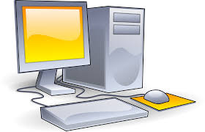
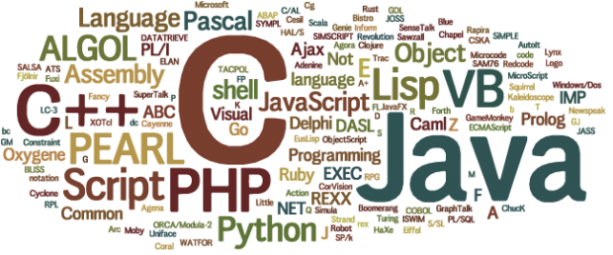
Week 4: History and Types of Computers and Programming
Notes:
Hardware: the part of a computer you can kick
stuff you have to buy, either up front at the Microsoft/Apple store or through the inflated prices of your smartphone plan that gave you the phone for “free”.
Q: How many programmers does it take to change a light bulb? A: None. It’s a hardware problem.
Q: How many hardware engineers does it take to change a light bulb? A: None. They’ll fix it in software.
Software: the part of a computer that kicks the hardware from the inside.
stuff that comes with the hardware (the operating system) which runs other stuff (application software, now just called “apps”) created (programmed) by people out of the goodness of their hearts (open source).
Software is like a sentence, a paragraph, a story, a novel. They all have a beginning, middle, and end. They are all created in a language. Like human languages, software languages evolved in different environments for different purposes.
BADware: see http://www.pcmag.com/encyclopedia/term/54210/wares
FATWARE: inefficient software with a BIG footprint; it tends to take over most of the CPU cycles, memory, and I/O bandwidth. Ever expanding computer code sizes and complexities in an application as new versions become available. Soon to pig out your computer, requiring an expensive upgrade. Adobe is a notable offender.
BLOATWARE: Applications that become overloaded with features that overwhelm computer memory and your memory. Sometimes called FeatureBloat. MS-Word may have been the application that spawned this term.
CRAPware (also called BLOATWARE): all the junk that comes with a Lenovo PC. Microsoft sells Signature Edition PCs with just the OS. VAPORWARE: Software (and sometimes hardware) that is announced by a company, but has not yet been (and may never be) released. RANSOMWARE: Code which, when encountered takes over your computer and locks up the files with the demand for money to release the data.
MALware and SPYware: watches what you do on your computer. Used for advertisement targeting and identity/credential theft.
C is to program microchips/ microcontrollers or make drivers. Low level programming, close to the hardware, small memory and processing footprint. UNIX was rewritten in C in 1972. Database systems were originally written in C. C is still alive and well in the Linux kernel and in small devices using firmware.
C++ useful for high performance real-time application (operating systems are written in C++, high performance video games) - Hard to work with (manual memory management – necessary for OS programming) + High portability (run on almost every kind of device)
- Runtime footprint higher than C
- improved software quality and reduced maintenance effort over C “C++ code is less complex, less prone to errors and requires less effort to maintain” (Bhattacharya and Neamtiu, 2011. “Assessing Programming Language Impact on Development and Maintenance: A Study on C and C++”)

Slide 10
Week 4: History and Types of Computers and Programming
Computers: electronic devices for storing and processing data according to instructions in a program
Users interact with Applications – high-level software.
Applications interact with an Operating System (OS)
OS: low-level software interacts with Hardware
Hardware: physical devices of a computer system controlled by an OS.

Slide 11
Programming & Programming Languages
A computer program is a list of instructions telling a computer system (the 'machine') what to do.
Computer programming (now just 'programming') is a process that leads from the formulation of a problem to an executable solution.
Source code is a human readable programming language compiled into software that is now executable code.
Audio/Visual Learning: https://www.lynda.com/Programming-Foundations-tutorials/What-programming/83603/90430-4.html
Week 4 provides history and context of the programming enviro.
Notes:
The terms program and software are often used interchangeably and potentially incorrectly.
See https://en.wikipedia.org/wiki/Software
and https://en.wikipedia.org/wiki/Computer_program
However, See https://teamtreehouse.com/community/the-difference-between-application-program-software
Program- A set of instructions telling a computer what to do.
Software- programs and other operating information used by a computer. Software can be made up of more than one program. All-encompassing term that is often used in contrast to hardware (the tangible parts of a computer)
Application- A program or group of programs designed for the end user. Application software (or "app") is a set of computer programs designed to permit the user to perform a group of coordinated functions, tasks, or activities. Application software is dependent on system software in order to run.
"All applications are programs, but a program is not necessarily an application. For example, there are always lots of programs running on the background of an operating system, but since they weren't developed for the end-user, they are not applications. On the other hand, Windows Media Player and Firefox, for example, are applications. They have a Graphical User Interface." - https://www.quora.com/What-is-the-difference-between-an-app-and-a-program

Slide 12
Week 5: Number Systems and Programming, Versioning
There are 10 types of people in the world:
01 Those who know binary
10 And the other nine

Slide 13
Number Systems & Software Versioning
A number system represents numeric values.
Ten fingers → base-10 decimal with positional notation
Ones, Tens, Hundreds, Thousands, …
ICT uses base-2 binary and base-16 hexadecimal
Ones, Twos, Fours, Eights, … Ones, Sixteens, 256s, …
Decimal vs Binary – significant implications for programmers
Software versioning is the process of assigning unique version names or numbers to states of computer software development.
Notes:
Binary number systems are for computers’ internal representation of numbers.
Decimal symbols output by computers are for humans.
The two are not the same as far as programmers are concerned.
Many early computers 1945-1960 used DECIMAL arithmetic logic units (ALU). By the end of the 1960s, all computers were using binary ALUs because they were cheaper and faster than decimal ALUs. Programmers had to suck it up and started thinking, “Will this integer ever be bigger than 37,767?” and “What do I do when I need a value between zero and one? There is no 1.5 in binary!” Floating point numbers estimate decimal place values – very bad for financial applications. Integers are accurate but they don't have fractional decimal places. We'll tell you what to do in Week 5.

Slide 14
Software Version Control Systems
Version control, revision control or source control, is the management of changes to software configurations, documents, computer programs, OS software, web sites, and other collections of information.
Apache Subversion (SVN)
Git and GitHub (used in IPC144)
Notes:
https://en.wikipedia.org/wiki/List_of_version_control_software

Slide 15
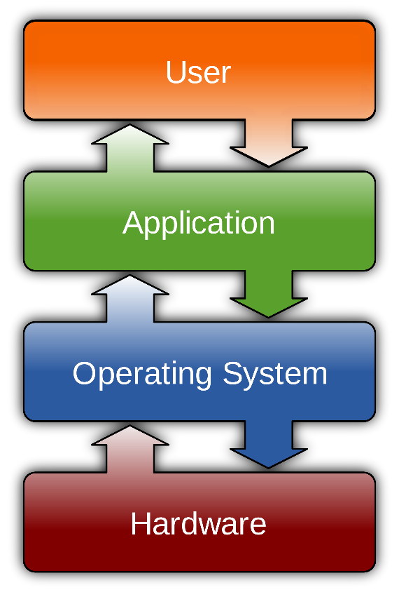
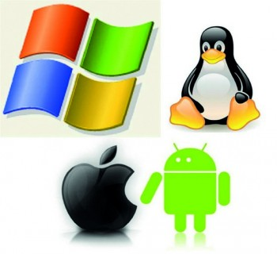
Week 6 - Hardware + Software = Platform System Terminology and Design
Notes:
Where does your program run? Nope, nope, nope. It runs on the User – that’s where the meaning is, the purpose, the benefit. Otherwise your program is just compiled code run by an OS on a chunk of silicon. Programs are for solving people's problems, not for chewing up CPU cycles.
When does a music become music? When it is written down in a score? Notes written on a staff are not much different from programming source code. A program run on a computer is similar to a musical score being played on an instrument. Neither becomes meaningful until people experience it.

Slide 16
Week 6 - Hardware + Software = Platform System Terminology and Design
System programming is developing software that interacts directly with the computer system itself.
Software design principles: architecture of Operating Systems that makes programming easier and safer.
Operating System (OS) is system software that supports a computer's basic functions, such as scheduling tasks, executing applications, and controlling memory, hardware, and peripheral devices.
Notes:
Week 4: about programming and systems
Week 6: the context and environment in which your programs run.

Slide 17
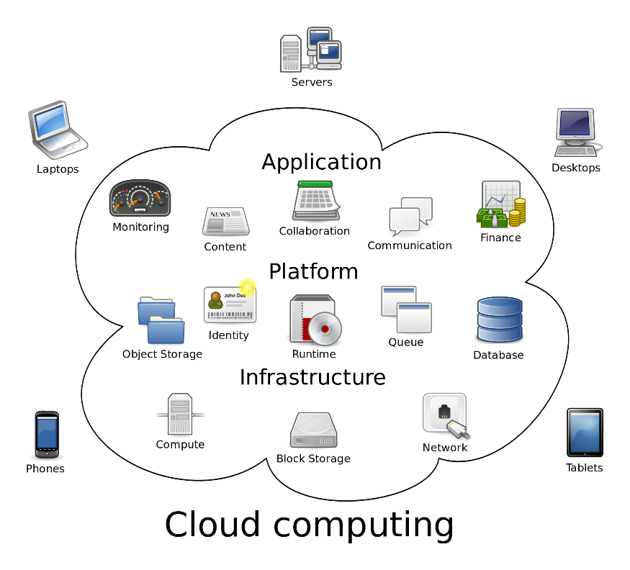
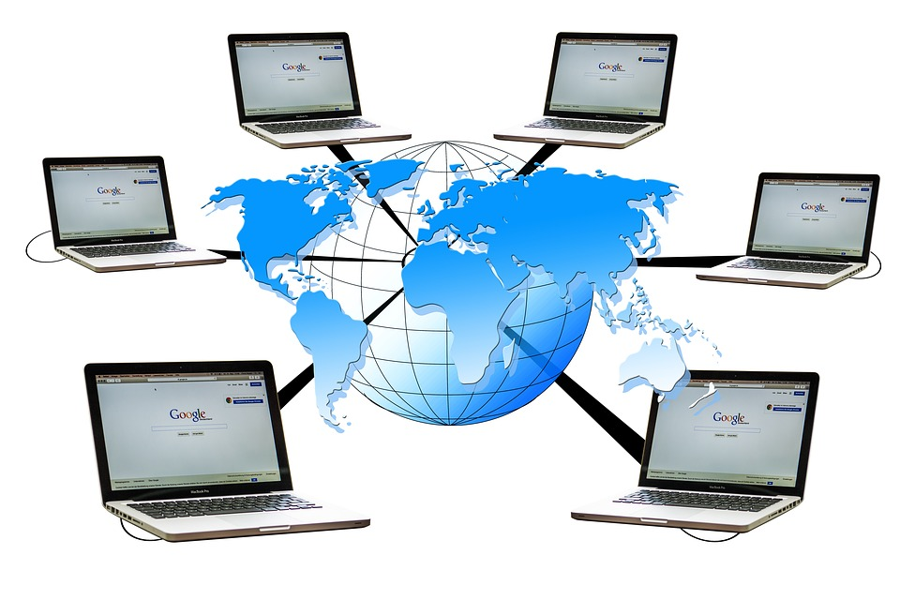
Week 7: Clients, Servers, Networks, and Clouds

Slide 18
Computer Networks
A computer network is a set of computers connected together for the purpose of sharing resources.
The Internet is a network of networks sharing a vast range of information resources and services.
“I have a device in my pocket containing the sum of all human knowledge… I use it to view pictures of cats, and start arguments w strangers" – Phil Veal

Slide 19
Cloud Computing & File Sharing
Cloud Computing is the practice of using remote servers via the Internet to store, manage, and process data, rather than a local server.
Audio/Visual Learning: https://www.lynda.com/Azure-tutorials/What-cloud-computing/128285/145485-4.html
Notes:
Week 7: what happens when computing is not just about one program running on one system?
It is about the implications of all systems being connected to each other.

Slide 20
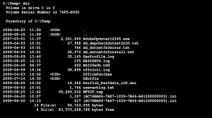

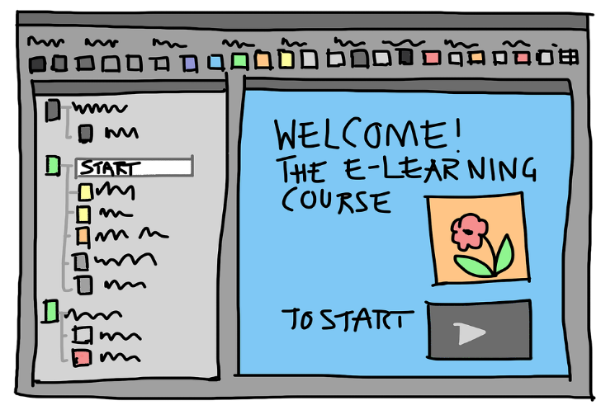
Week 8: User Interfaces, Time Management and Powershell

Slide 21
CLI – Command Line Interface or PTUI – Plain Text User Interface
Notes:
PTUI is a joke. It is pronounced “p-too-ee” as in the cartoons when a character spits.

Slide 22
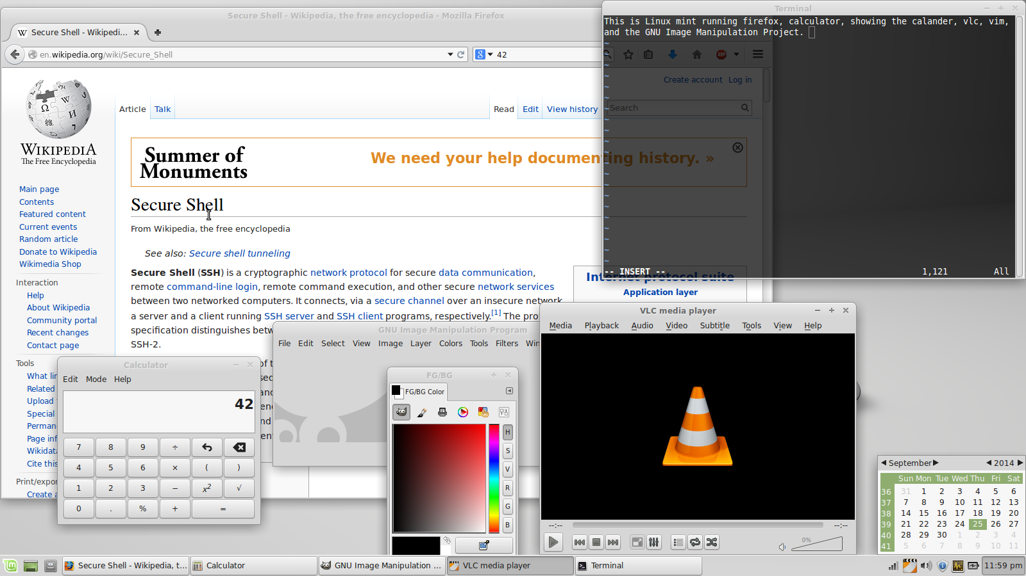
GUI
Notes:
Now where is that window buried?

Slide 23
Human Computer Interaction
HCI: what you see and touch, the "look and feel".
CLI: Command Line Interface uses textual keyboard input and character output to control an OS
GUI: Graphical User Interface uses graphical elements such as windows, icons, and menus. GUI elements are manipulated with pointing devices (e.g. mouse) and/or touch in addition to keyboard input.
Notes:
Human Computer Interaction: what you can see and touch. Known as the "look and feel". HCI is the interaction between user and software using devices such as screens, keyboards, and mice; also voice recognition.
Advantages and dangers of different User Interfaces.

Slide 24
Time Management
Time management is the act or process of planning and exercising conscious control over the amount of time spent on specific activities, especially to increase effectiveness, efficiency or productivity.
Effective time management can help increase productivity and reduce stress. Increase your chance to stay organized, keep a clear mind, and be more productive (in work, study, and life.)
Notes:
The secret of Time Management:
Time is not something you have or don't have.
Time is a choice you make.
…more in Week 8

Slide 25


Week 9 - File Compression and Backup

Slide 26
File Compression & Backup
File compression is a process of packaging a file (or files) to use less disk space or bandwidth.
Backed up is two copies in geographically separate locations on independent systems.
Methods and disciplines of professional backup.
The punchline: Backup doesn't matter. Only Restore matters.
Notes:
It is not completely backed up unless you have two copies in geographically separate locations on independent systems.
N.B. two way synchronization of your PC's files with a cloud service makes your system interdependent with the cloud.
Restoring from backup is disaster recovery…we hope we never have to use our backup.

Slide 27
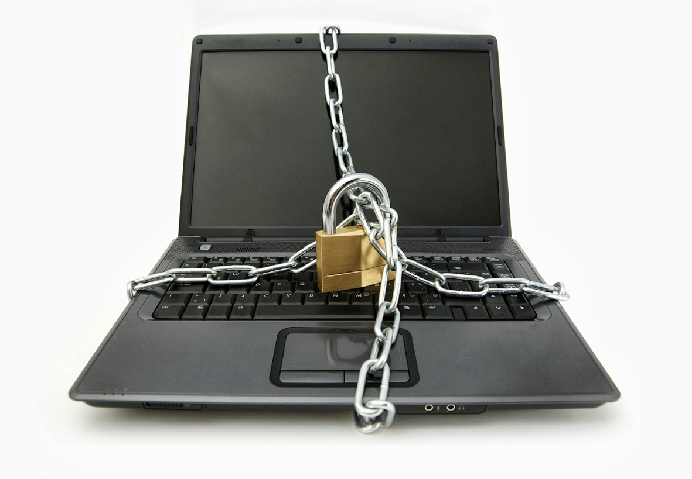
Week 10: Authentication and Security

Slide 28
Authentication & Authorization
Authentication verifies a user's identity e.g. with email@address and password
Authorization gives a user (or a program) permission to do or to access something. e.g. open or change a file, read a directory
Password issues, problems, and safe storage
Security issues that might keep you up at night

Slide 29
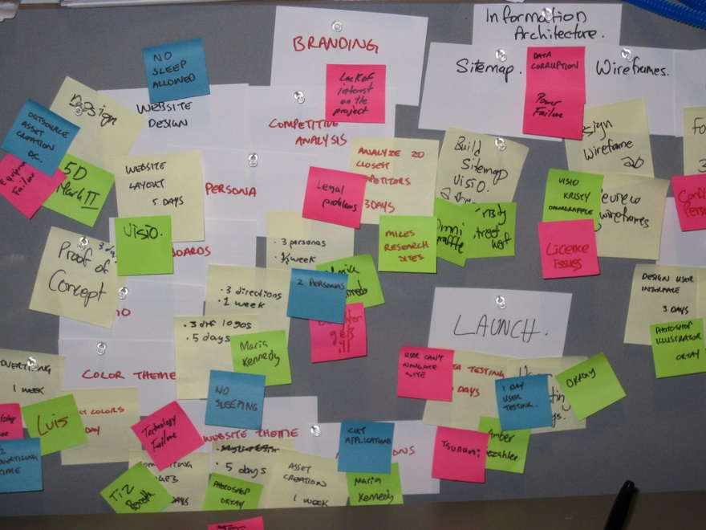

Week 11 - IT Projects, IT Jobs, and Project Management

Slide 30
IT Projects, Jobs, Project Management
Systems Analysis – What's the problem?
System Development – What's the solution?
Programming or "Implementation" is part of this
Project Management – Make it happen!
the discipline of initiating, planning, executing, controlling, and closing the work of a team

Slide 31



Week 12: Software Licensing, Intellectual Property, Privacy

Slide 32
Closed vs Open Source, Licensing
A software license is a legal instrument governing the use or redistribution of both Close and Open software.
Closed source (or proprietary software) means the source code is copyrighted, not published or shared.
Only compiled software is distributed under restrictive licensing e.g. IBM, Apple, Windows operating systems
Open-source software's source code is shared and developed in a collaborative public manner with copyleft or permissive licensing.
Notes:
Knowing the differences in licensing is important, especially for start-up companies.
It can mean the difference between you buying a bigger, nicer house or losing the house you have.

Slide 33
Intellectual Property and Related Rights, and Data Privacy in IT
Intellectual Property is a work or invention that is the result of creativity to which one has rights, and for which one may apply for a patent (new idea), copyright (expression of an idea), or trademark (icon of a unique concept, technology, or company).
Data Privacy: data belongs to the person, not the organization that collects it.
Notes:
Organizations which collect information from people are responsible for the data's proper use and security.
Unless you use Facebook, Instagram, or other social media services to which you agree to give them all rights to your data.

